Slide 1
Health suggesting chat-bot
DR.FLAMEBUOYANT
- VIBHAV,MOHINISH,ABHIJITH

Slide 2
Why should we consult a doctor for minor problems like cough , cold……..???
What should we do incase of emergency situations and have no access to Doctor…???
To solve these kind of problms we have come up with the idea of Chatbot named Dr.FlameBuoyant.
Dr.FlameBuoyant can help you give valuable and necessary information regarding different kinds of health problems.
Dr.FlameBuoyant for anyone,anywhere,anytime

Slide 3
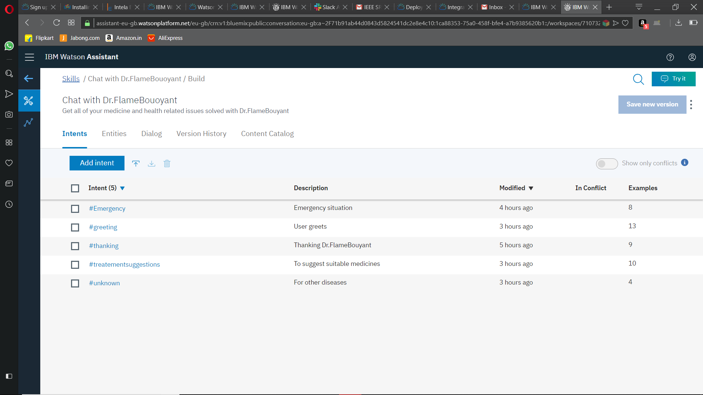
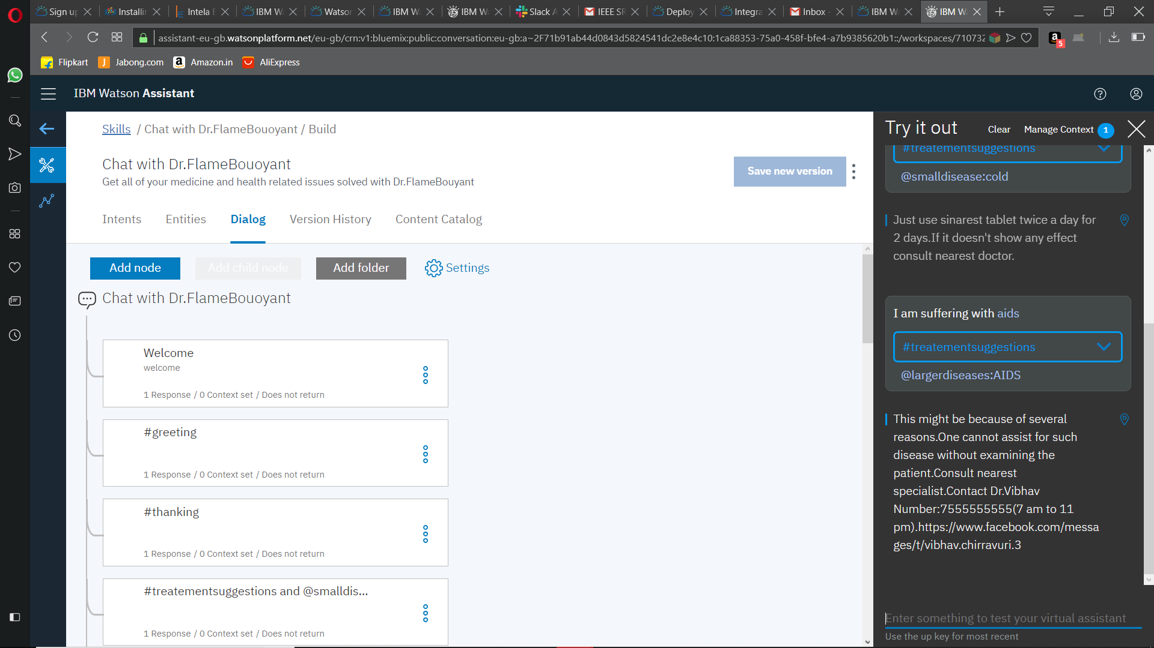
CREATING A CHAT-BOT

Slide 4
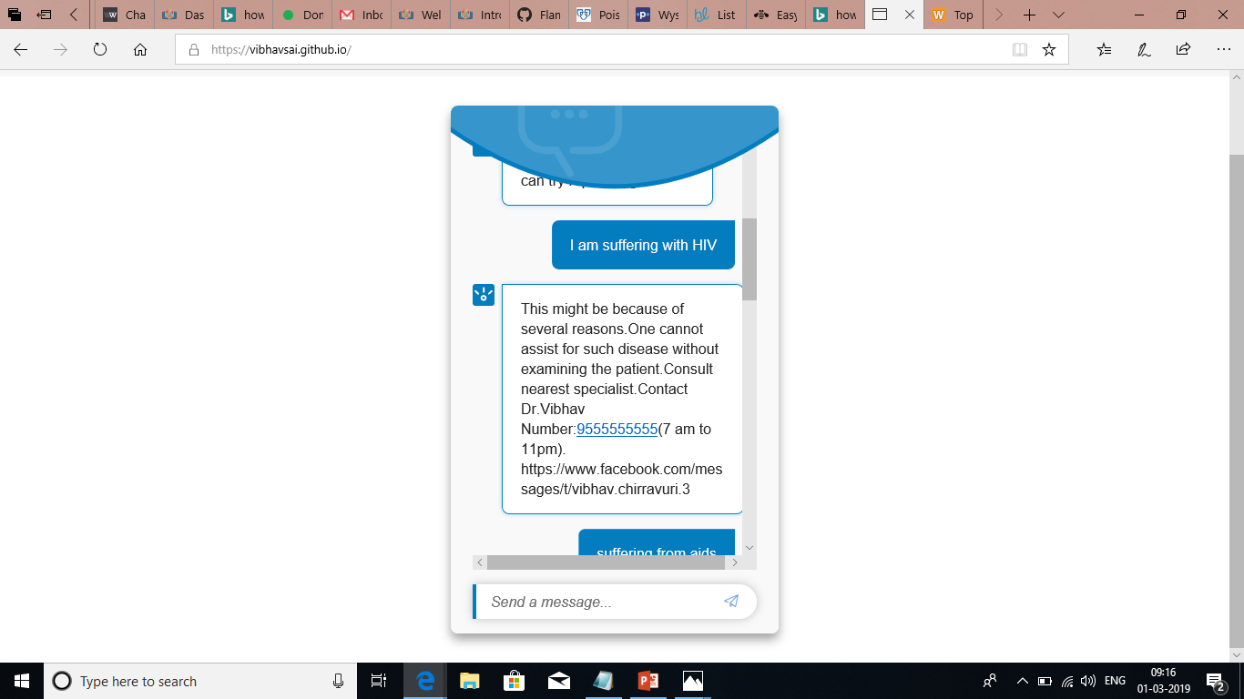
DEPLOYING CHAT-BOT
WE HAVE DEPLOYED OUR CHAT-BOT THROUGH GITHUB PLATFORM.

Slide 5
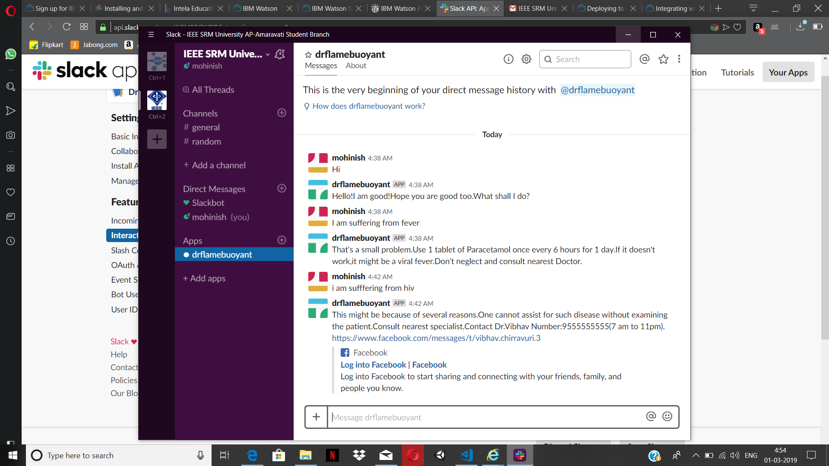
SLACK INTEGRATION FROM IBM CLOUD
AFTER CREATING A CHAT-BOT WE INTEGRATED THIS INTO SLACK.SO THAT THE CHATBOT CAN BE HOSTED BY SLACK

